Slide 1
Photos correspondant auX CHOIX 1
Notes:
En référence aux activités H5P

Slide 2
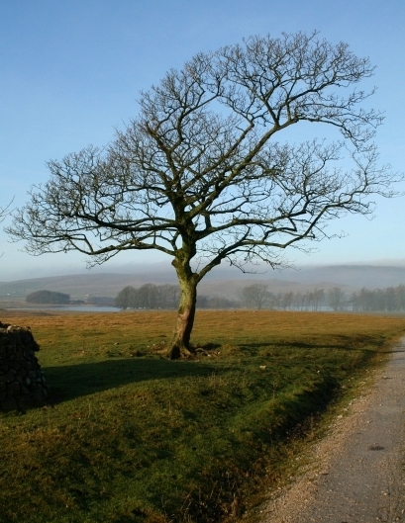
Wikicommons CC-BY-SA 2.0 Steve Partridge
Notes:
By Steve Partridge, CC BY-SA 2.0, https://commons.wikimedia.org/w/index.php?curid=13176301

Slide 3
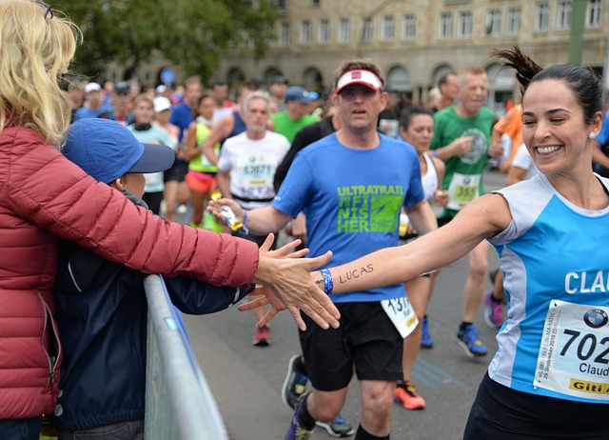
Licence Pixabay Content wal_172619
Notes:
Image par <a href="https://pixabay.com/fr/users/wal_172619-12138562/?utm_source=link-attribution&utm_medium=referral&utm_campaign=image&utm_content=4631297">wal_172619</a> de <a href="https://pixabay.com/fr//?utm_source=link-attribution&utm_medium=referral&utm_campaign=image&utm_content=4631297">Pixabay</a>

Slide 4
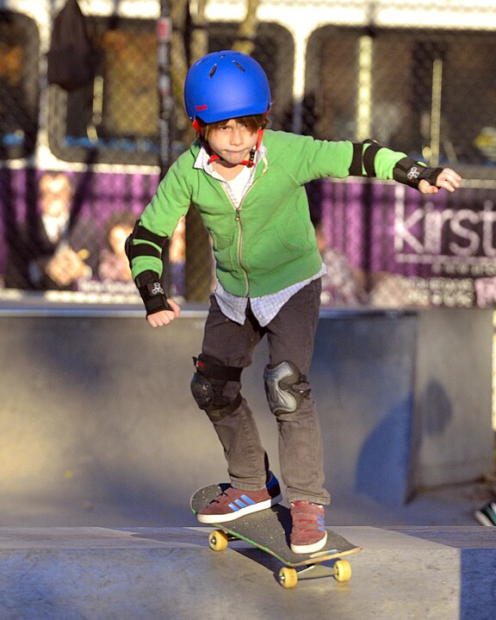
Wikicommons CC-BY-SA 2.0 Steven Pisano
Notes:
By Steven Pisano - https://www.flickr.com/photos/stevenpisano/10963643666/, CC BY 2.0, https://commons.wikimedia.org/w/index.php?curid=140420788

Slide 5
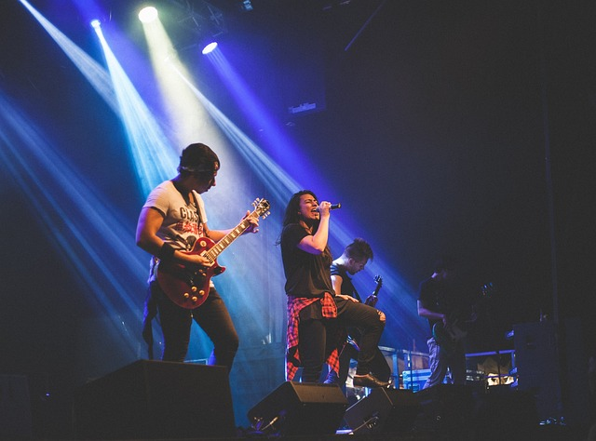
Licence Pixabay Content Stocksnap
Notes:
Image par <a href="https://pixabay.com/fr/users/stocksnap-894430/?utm_source=link-attribution&utm_medium=referral&utm_campaign=image&utm_content=2604786">StockSnap</a> de <a href="https://pixabay.com/fr//?utm_source=link-attribution&utm_medium=referral&utm_campaign=image&utm_content=2604786">Pixabay</a>

Slide 6
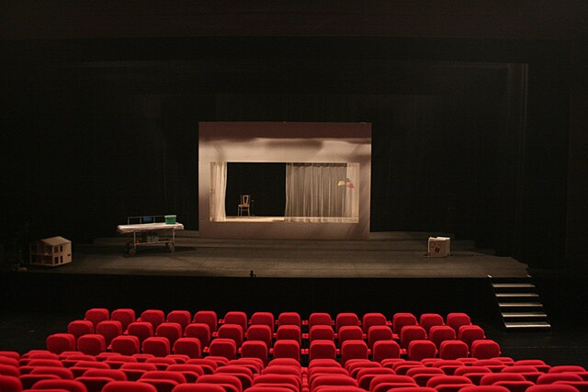
Wikicommons CC-BY-SA 3.0 Théâtre ONYX
Notes:
By Théâtre ONYX - Own work, CC BY-SA 3.0, https://commons.wikimedia.org/w/index.php?curid=30725062

Slide 7
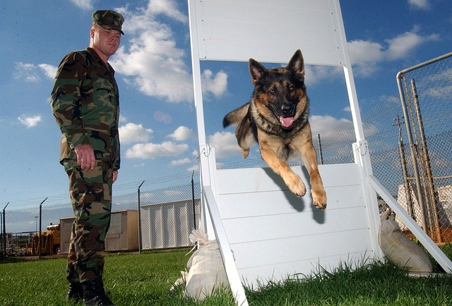
Licence Pixabay Content 12019
Notes:
Image par <a href="https://pixabay.com/fr/users/12019-12019/?utm_source=link-attribution&utm_medium=referral&utm_campaign=image&utm_content=80121">12019</a> de <a href="https://pixabay.com/fr//?utm_source=link-attribution&utm_medium=referral&utm_campaign=image&utm_content=80121">Pixabay</a>

Slide 8
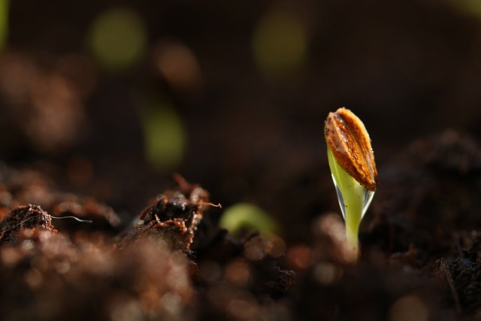
Licence Pixabay Content Katarina Vulcova
Notes:
Image par <a href="https://pixabay.com/fr/users/katerinavulcova-7453549/?utm_source=link-attribution&utm_medium=referral&utm_campaign=image&utm_content=3944361">katerinavulcova</a> de <a href="https://pixabay.com/fr//?utm_source=link-attribution&utm_medium=referral&utm_campaign=image&utm_content=3944361">Pixabay</a>

Slide 9
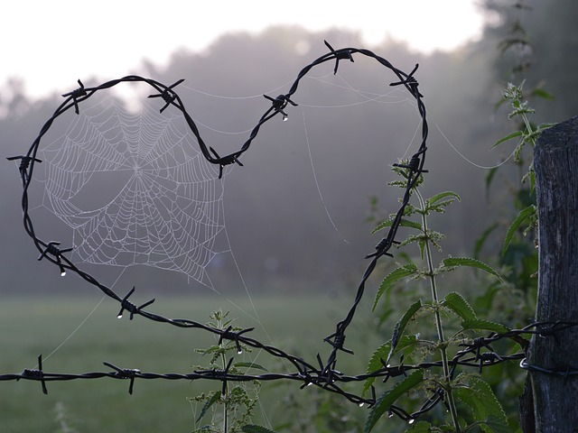
Licence Pixabay Content 4117354
Notes:
Image par <a href="https://pixabay.com/fr/users/4117354-4117354/?utm_source=link-attribution&utm_medium=referral&utm_campaign=image&utm_content=1949778">4117354</a> de <a href="https://pixabay.com/fr//?utm_source=link-attribution&utm_medium=referral&utm_campaign=image&utm_content=1949778">Pixabay</a>

Slide 10
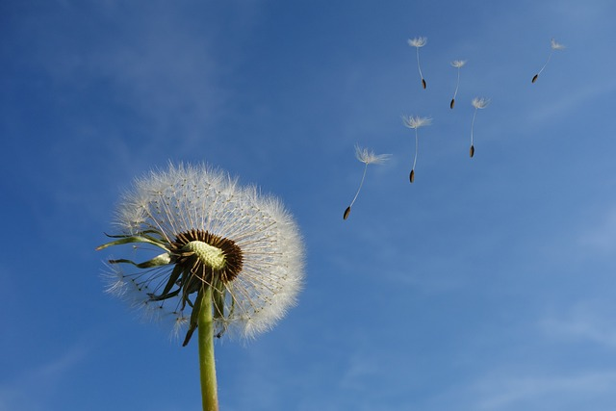
Pixabay Licence Content Michael Schwarzenberger
Notes:
Image par <a href="https://pixabay.com/fr/users/blickpixel-52945/?utm_source=link-attribution&utm_medium=referral&utm_campaign=image&utm_content=463928">Michael Schwarzenberger</a> de <a href="https://pixabay.com/fr//?utm_source=link-attribution&utm_medium=referral&utm_campaign=image&utm_content=463928">Pixabay</a>

Slide 11
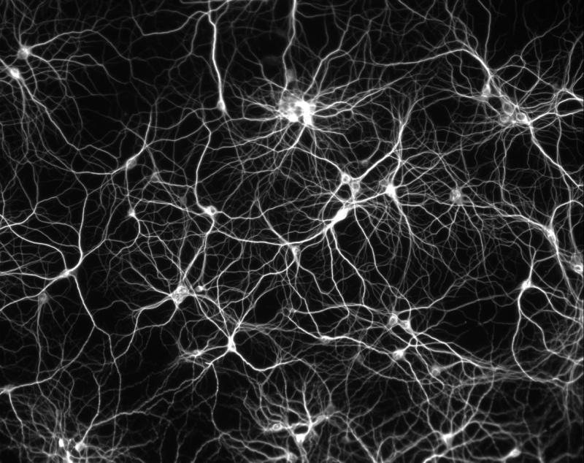
Wikcommons CC-BY-SA 4.0 Else If Then
Notes:
By Else If Then - Own work, CC BY-SA 4.0, https://commons.wikimedia.org/w/index.php?curid=47616876

Slide 12
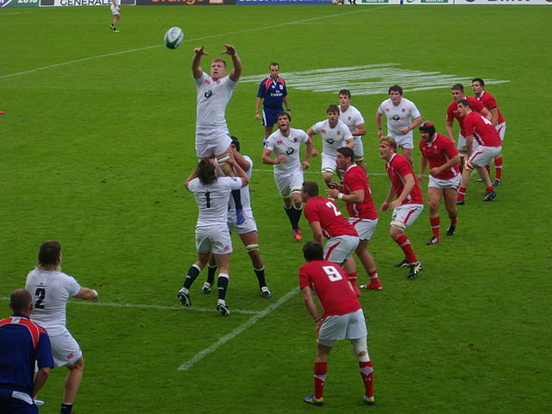
Wikcommons CC-BY-SA 3.0 Fabb5669
Notes:
By Fab5669 - Own work, CC BY-SA 3.0, https://commons.wikimedia.org/w/index.php?curid=27445217

Slide 13
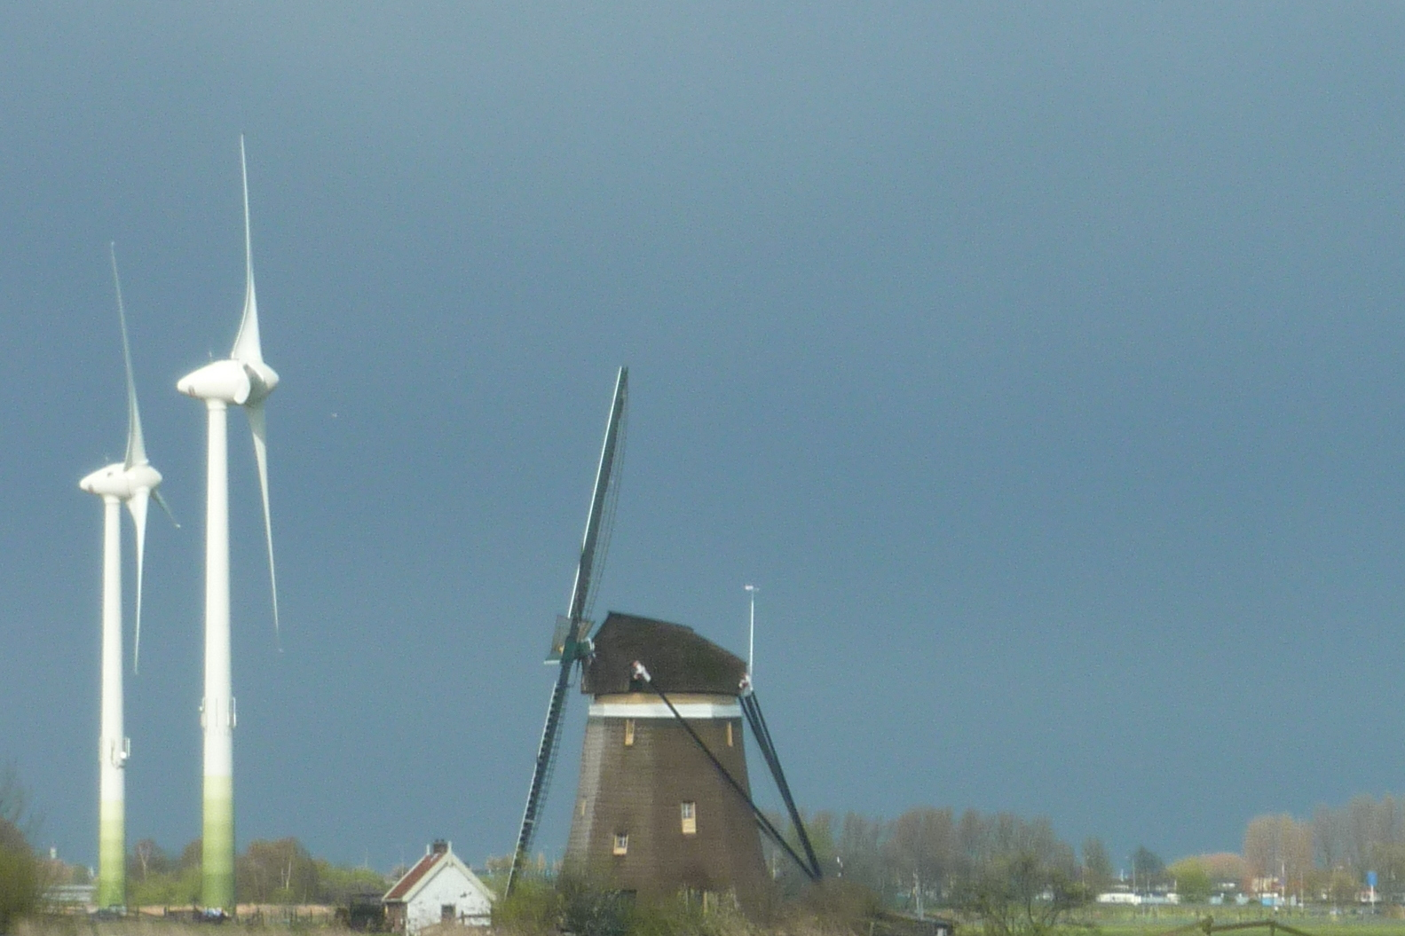
CC-BY-SA-NC Marie Jidenko
Notes:
Marie JIDENKO CC-BY-NC-SA

Slide 14
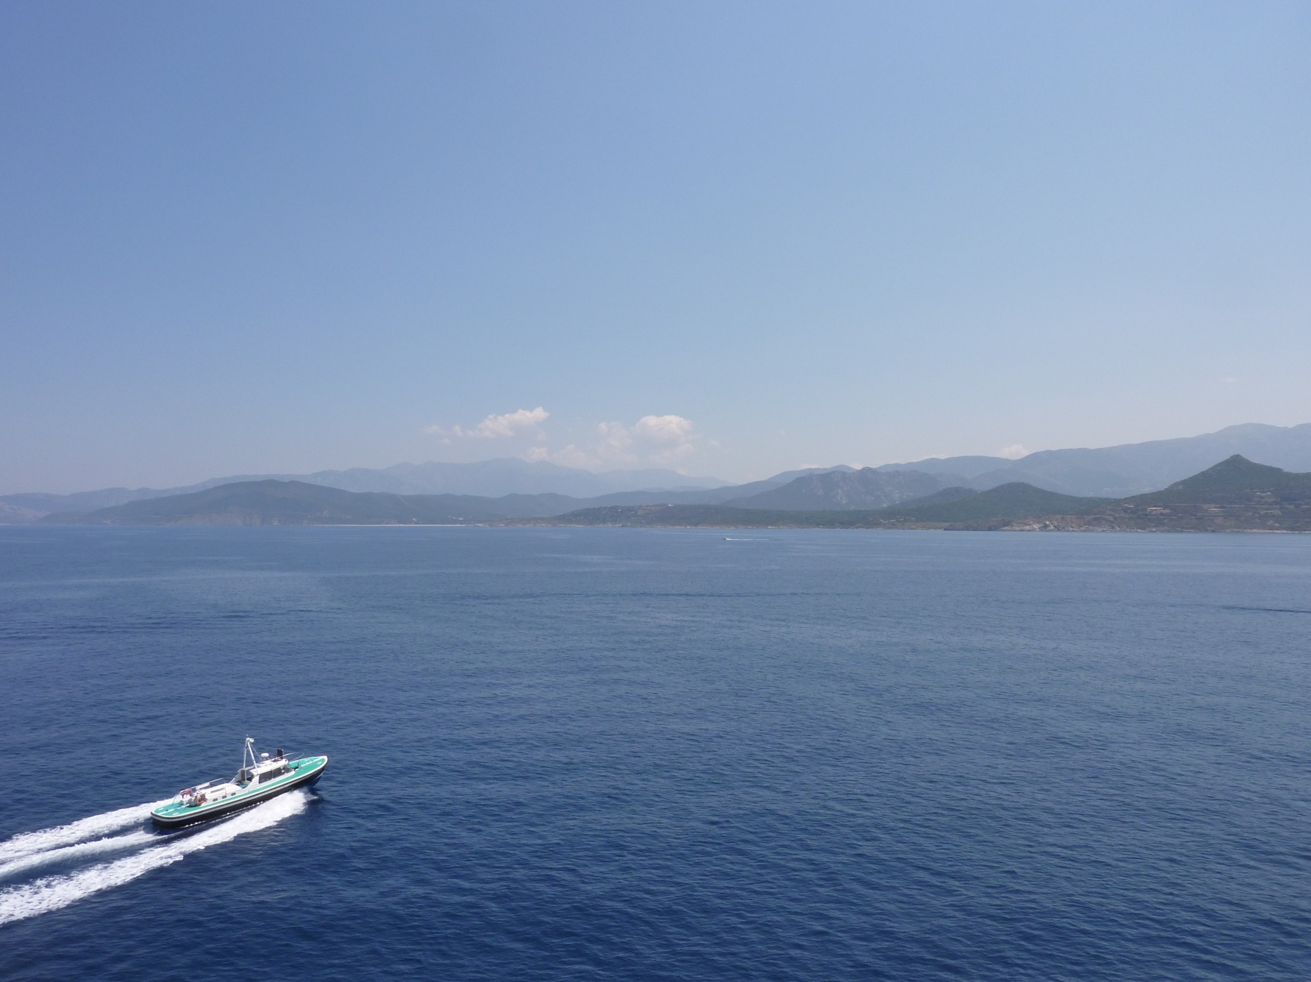
CC-BY-SA-NC Marie Jidenko
Notes:
Marie JIDENKO CC-BY-NC-SA

Slide 15
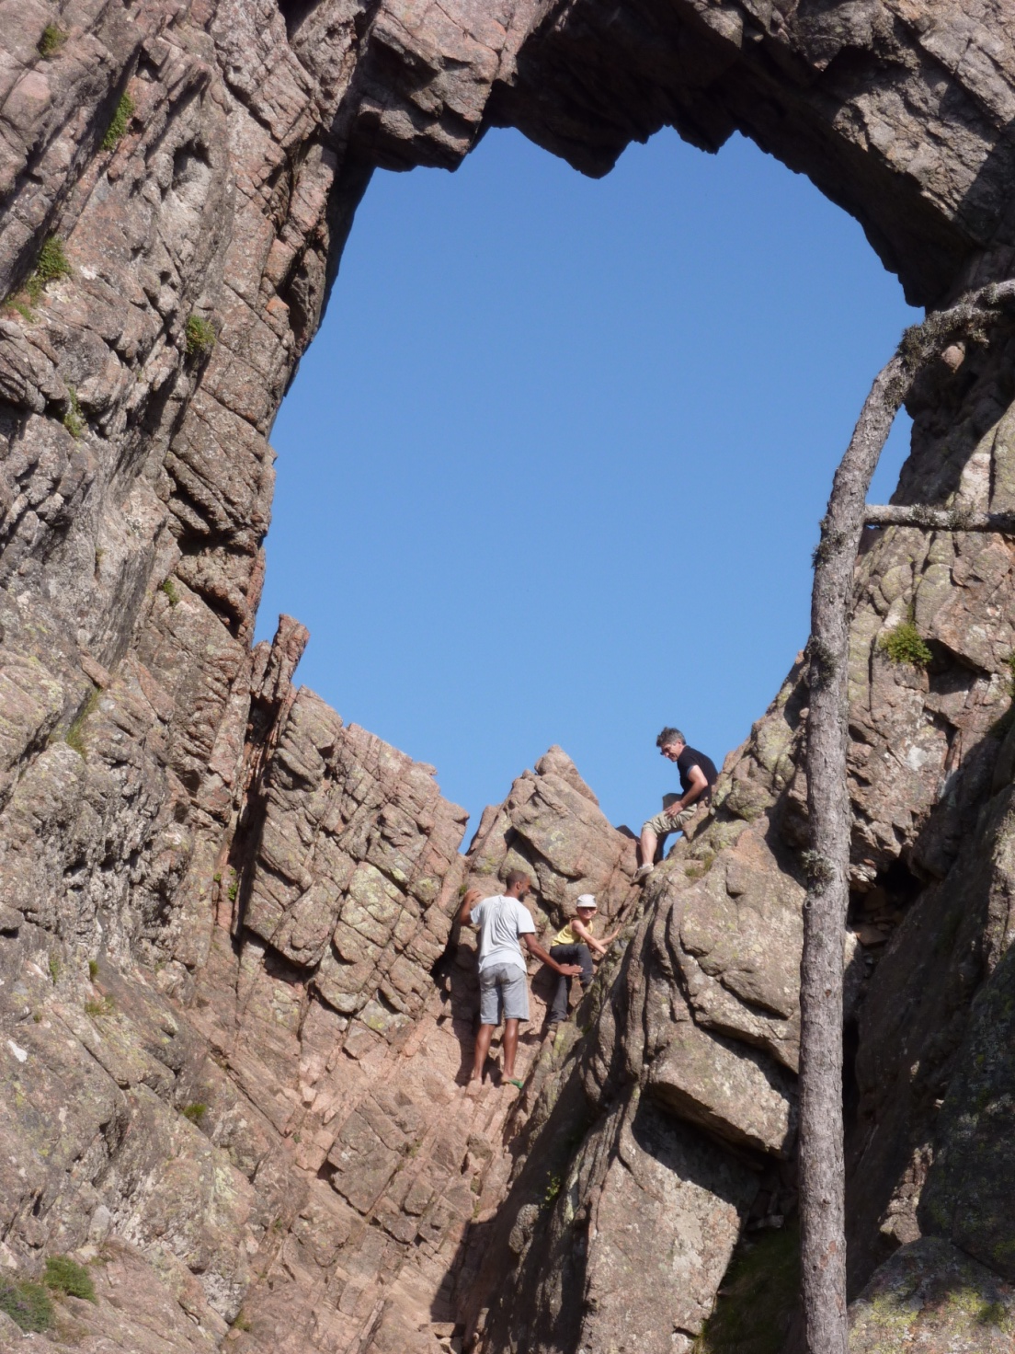
CC-BY-SA-NC Marie Jidenko
Notes:
Marie JIDENKO CC-BY-NC-SA

Slide 16
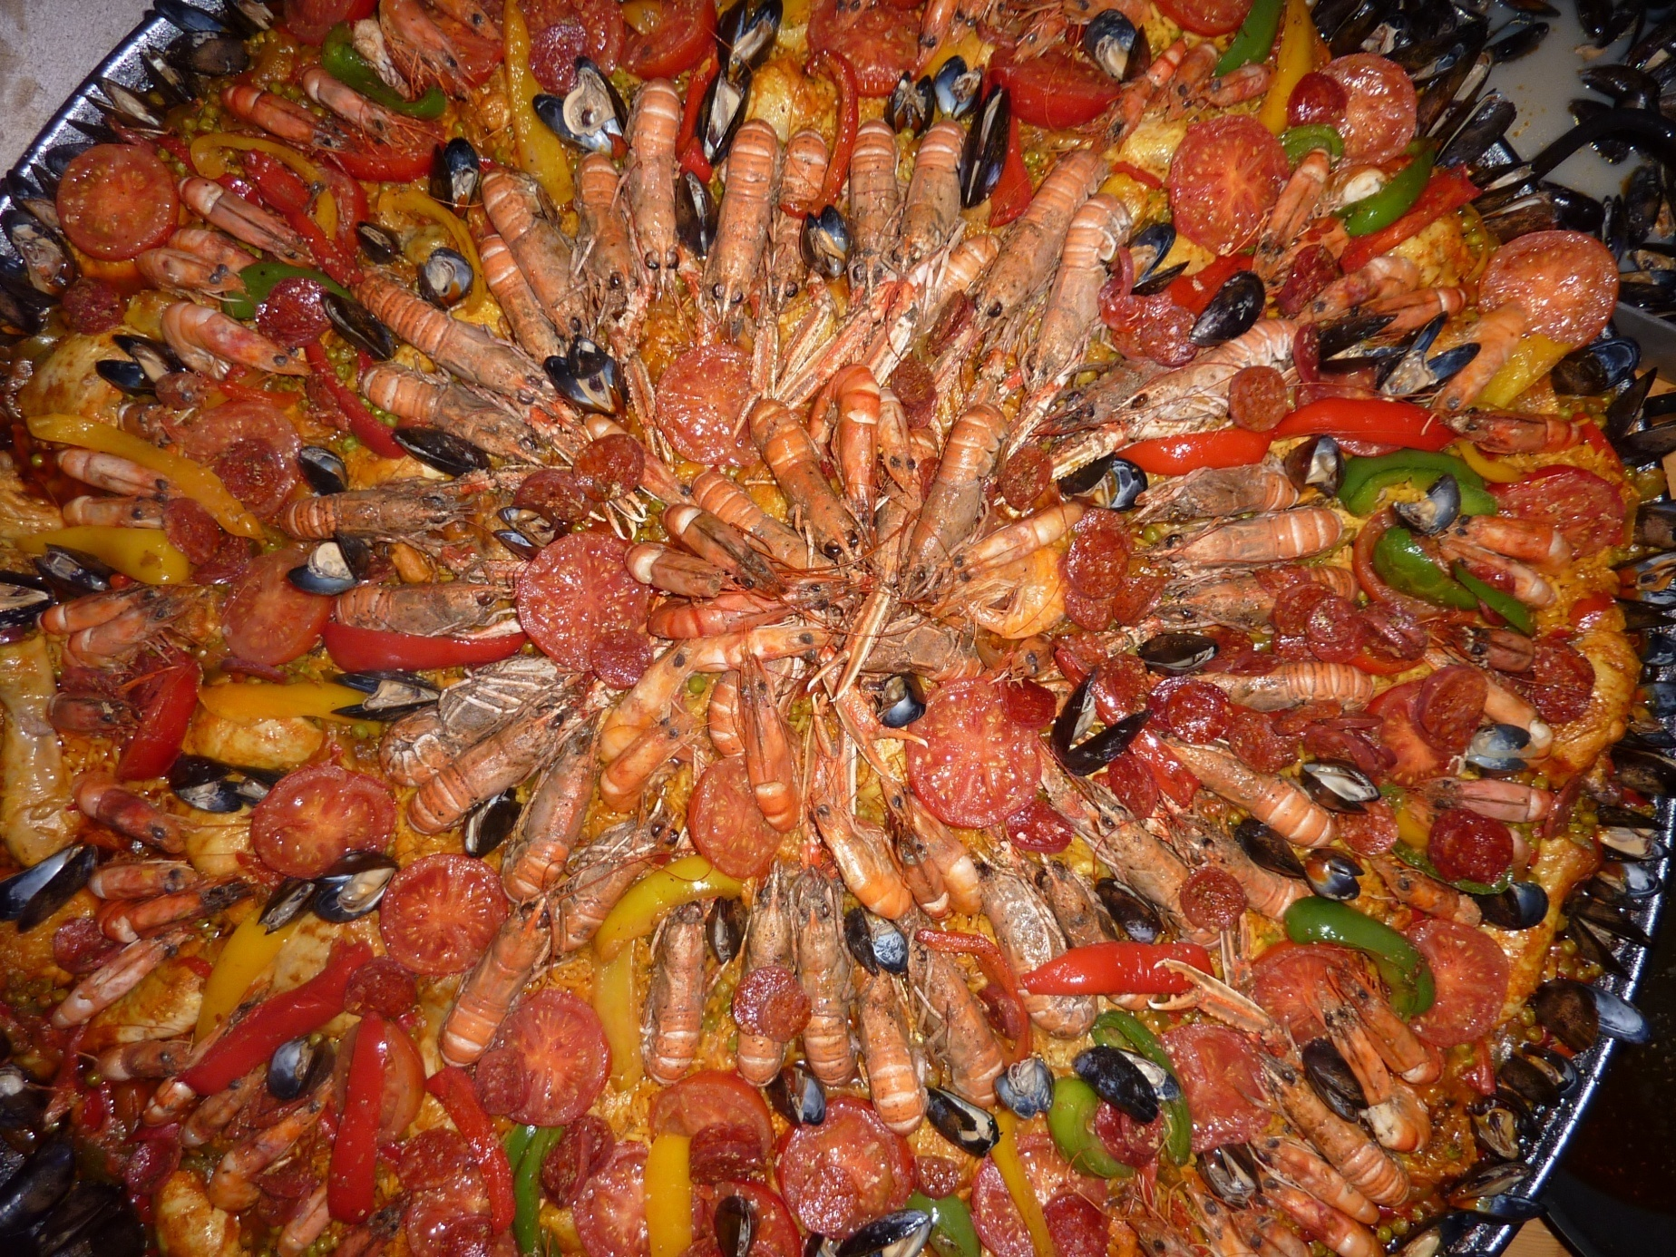
CC-BY-SA-NC Marie Jidenko
Notes:
Marie JIDENKO CC-BY-NC-SA

Slide 17
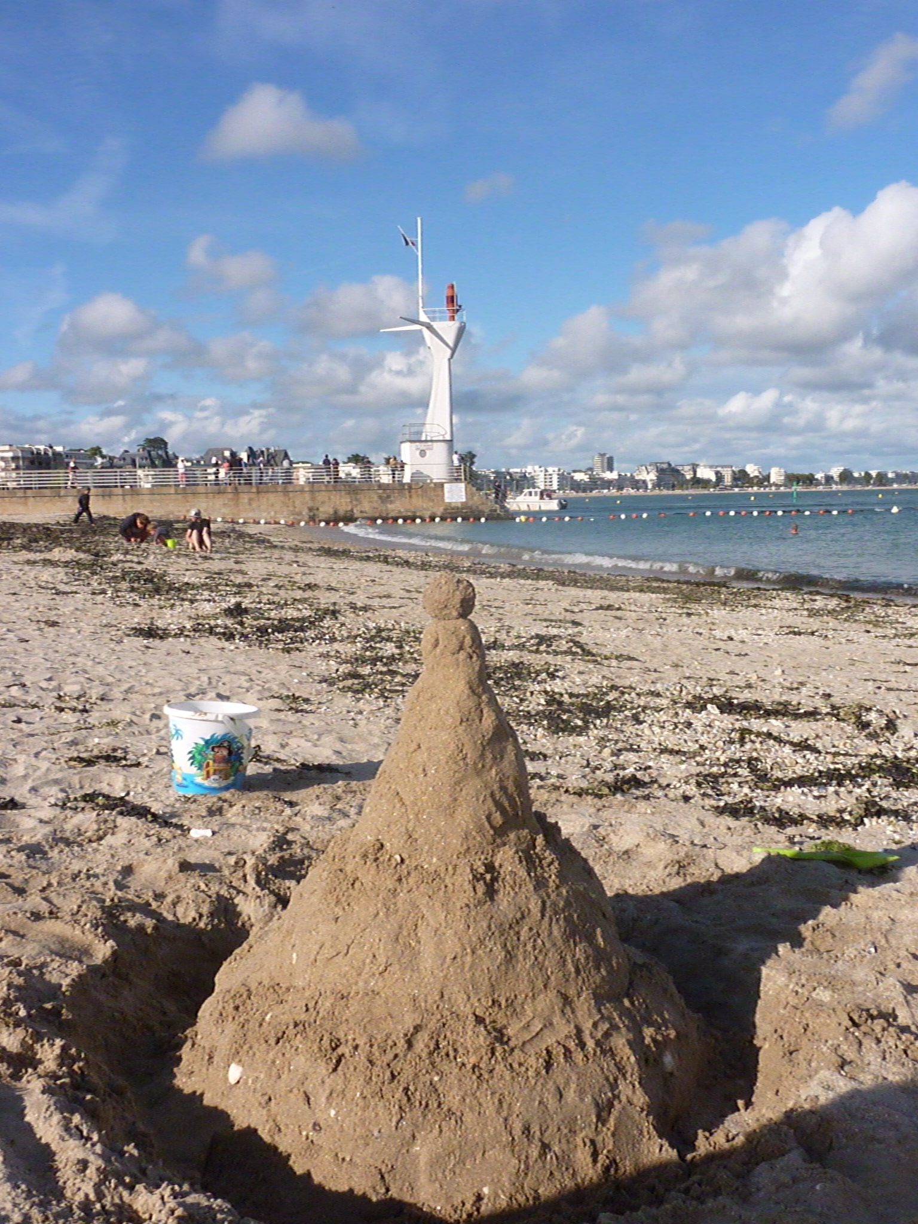
CC-BY-SA-NC Marie Jidenko
Notes:
Marie JIDENKO CC-BY-NC-SA

Slide 18
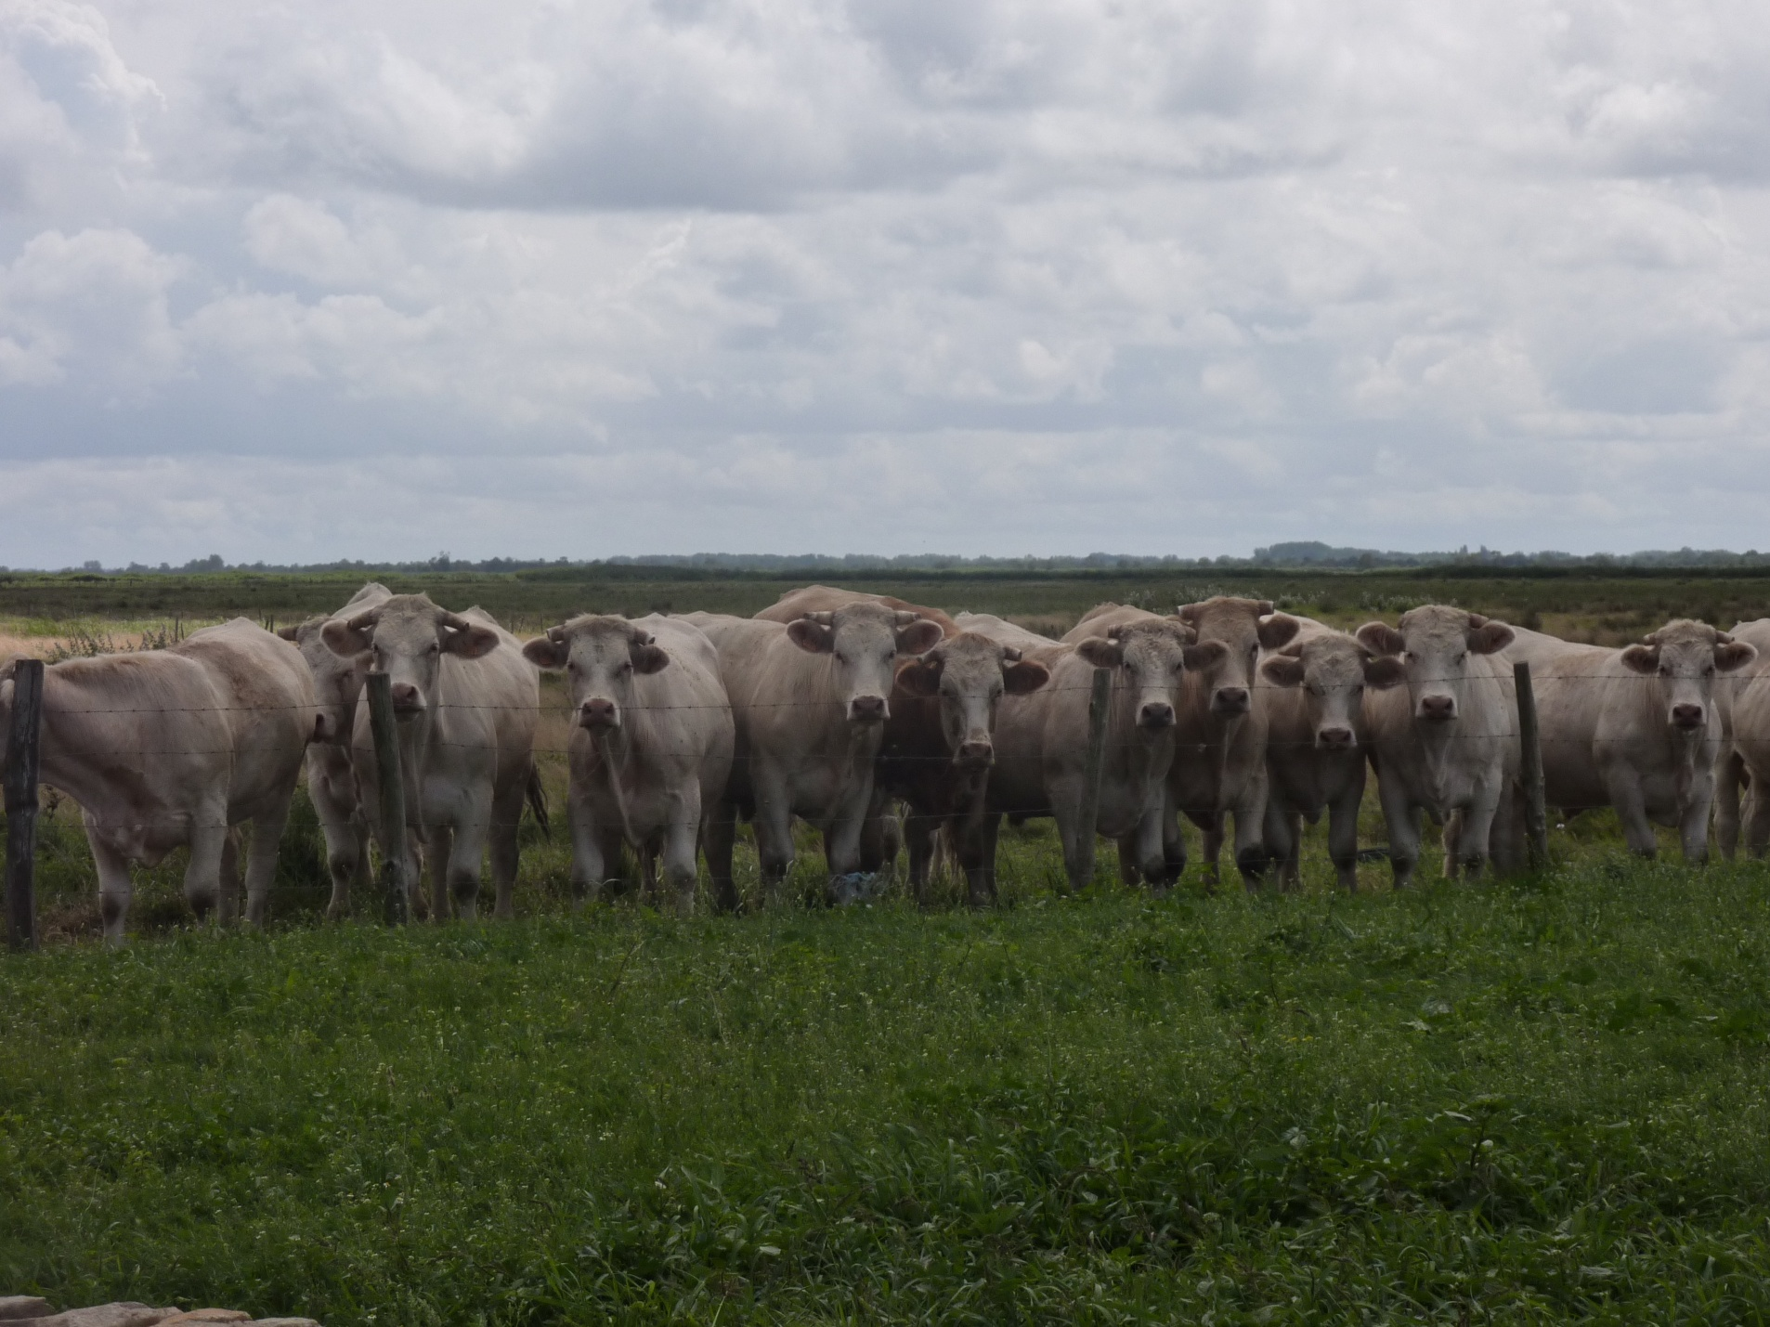
CC-BY-SA-NC Marie Jidenko
Notes:
Marie JIDENKO CC-BY-NC-SA

Slide 19
Licence Pixabay Content Jan Mateboer
Notes:
Image par <a href="https://pixabay.com/fr/users/jan_photo-2842014/?utm_source=link-attribution&utm_medium=referral&utm_campaign=image&utm_content=4226688">Jan Mateboer</a> de <a href="https://pixabay.com/fr//?utm_source=link-attribution&utm_medium=referral&utm_campaign=image&utm_content=4226688">Pixabay</a>

Slide 20
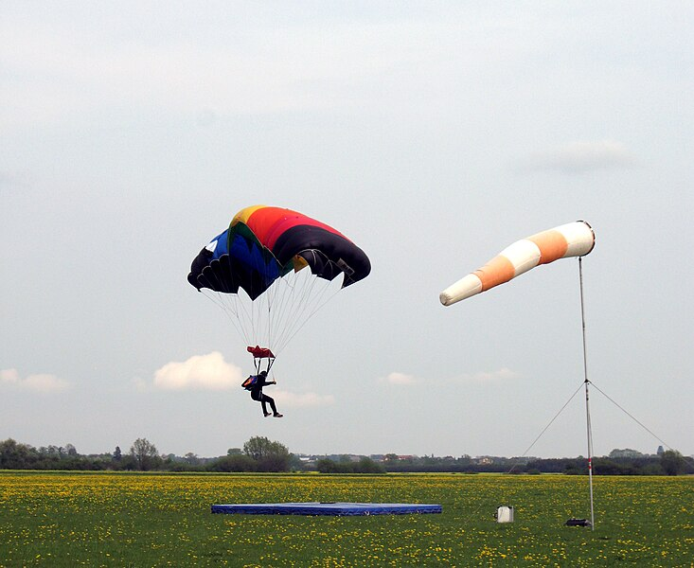
Wikicommons Domaine public Masur
Notes:
Source: https://commons.wikimedia.org/wiki/File:Parachute_precise_landing.jpg consultée le 9fev 2024
Auteur: Masur
Licence: Public Domain

Slide 21
Photos correspondant auX CHOIX 2
Notes:
En référence aux activités H5P

Slide 22
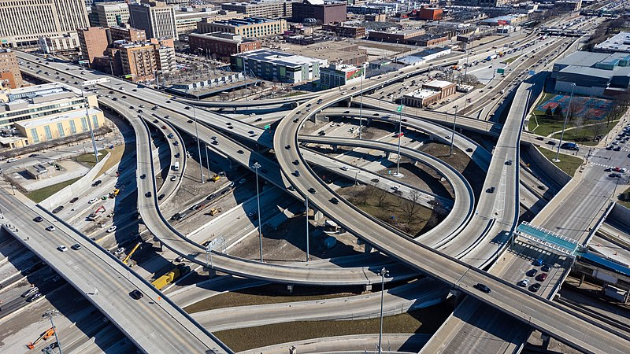
WikicommonsCC-BY-SA Sea Cow
Notes:
Source: https://commons.wikimedia.org/wiki/File:Jane_M._Byrne_Interchange_4-1-22.jpgconsultée le 9fev 2024
Auteur: Sea cow
Licence: CC-BY-SA

Slide 23
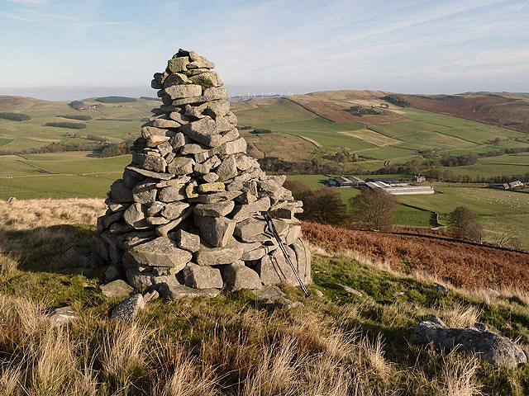
Wikicommons CC-BY-SA Walter Baxter
Notes:
Source: https://commons.wikimedia.org/wiki/File:A_cairn_at_Cauld_Face_-_geograph.org.uk_-_3749090.jpg consultée le 9fev 2024
Auteur: Walter Baxter
Licence: CC-BY-SA

Slide 24
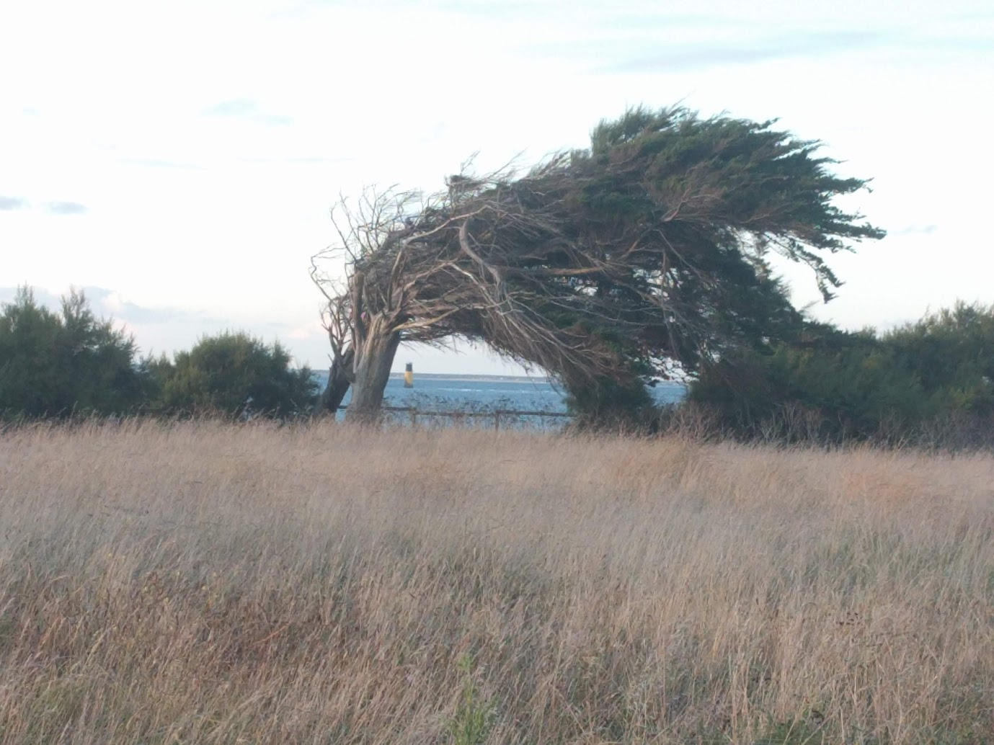
CC-BY-SA-NC Marie Jidenko
Notes:
Marie JIDENKO CC-BY-SA-NC

Slide 25
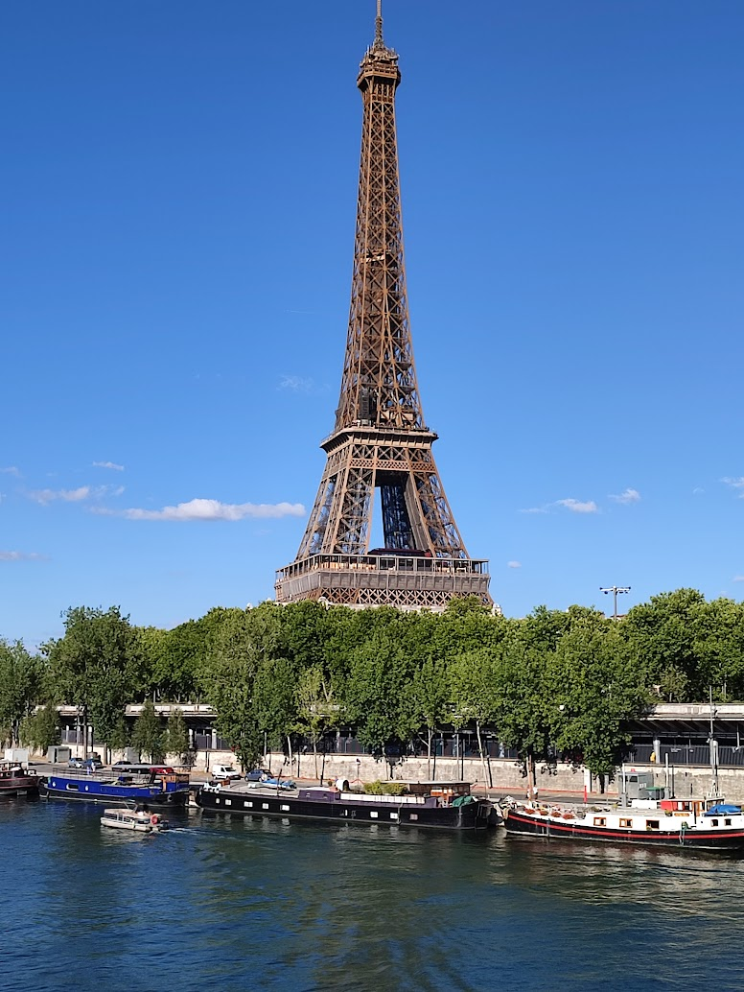
CC-BY-SA-NC Marie Jidenko
Notes:
Marie JIDENKO CC-BY-SA-NC

Slide 26
Licence Pixabay Content Jan Mateboer
Notes:
Licence Pixabay Content Jan Mateboer

Slide 27
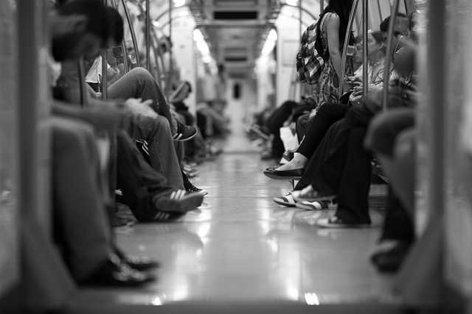
Licence Pixabay Content Engin Akyurt
Notes:
Engin Akyurt from Pixabay
Image par <a href="https://pixabay.com/fr/users/engin_akyurt-3656355/?utm_source=link-attribution&utm_medium=referral&utm_campaign=image&utm_content=2373323">Engin Akyurt</a> de <a href="https://pixabay.com/fr//?utm_source=link-attribution&utm_medium=referral&utm_campaign=image&utm_content=2373323">Pixabay</a>

Slide 28
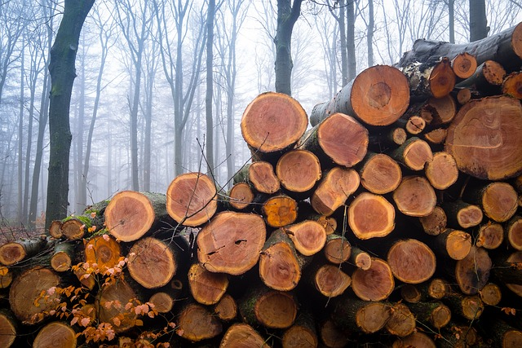
Licence Pixabay Content Jan Mateboer
Notes:
Image par <a href="https://pixabay.com/fr/users/jan_photo-2842014/?utm_source=link-attribution&utm_medium=referral&utm_campaign=image&utm_content=4259832">Jan Mateboer</a> de <a href="https://pixabay.com/fr//?utm_source=link-attribution&utm_medium=referral&utm_campaign=image&utm_content=4259832">Pixabay</a>

Slide 29
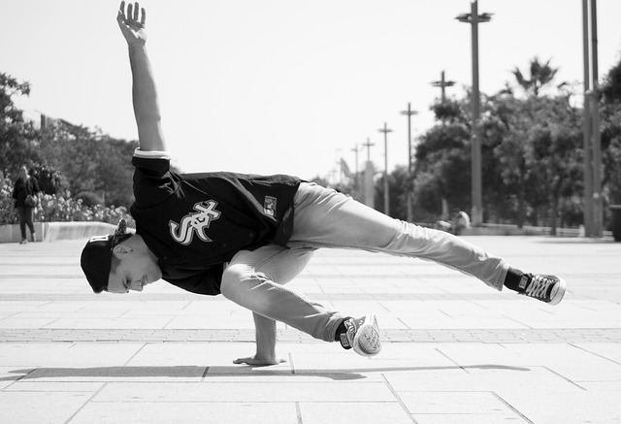
Licence Pixabay Content Anastasia Makarevich
Notes:
Image by <a href="https://pixabay.com/users/anastasia_makarevich-4811614/?utm_source=link-attribution&utm_medium=referral&utm_campaign=image&utm_content=4700009">Anastasia Makarevich</a> from <a href="https://pixabay.com//?utm_source=link-attribution&utm_medium=referral&utm_campaign=image&utm_content=4700009">Pixabay</a>

Slide 30
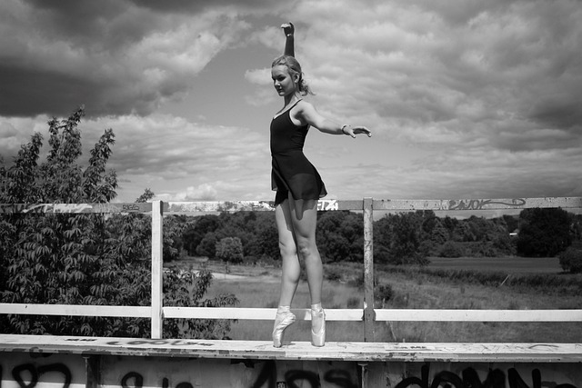
Licence Pixabay Content un-perfekt
Notes:
https://pixabay.com/users/un-perfekt-9295476/?utm_source=link-attribution&utm_medium=referral&utm_campaign=image&utm_content=3757353

Slide 31
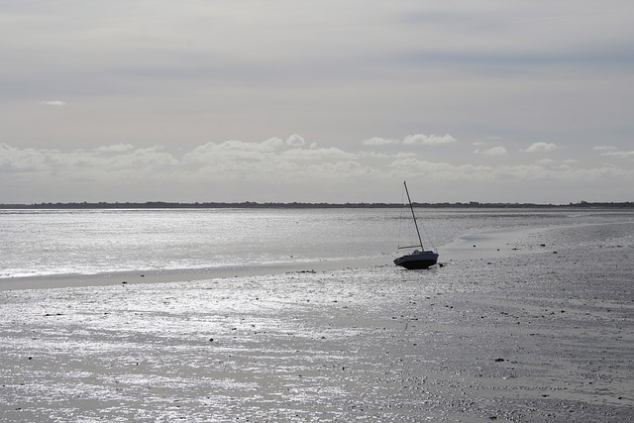
Licence Pixabay Content Julia Schecker
Notes:
Image par <a href="https://pixabay.com/fr/users/jules2413-24684247/?utm_source=link-attribution&utm_medium=referral&utm_campaign=image&utm_content=7941563">Julia Schecker</a> de <a href="https://pixabay.com/fr//?utm_source=link-attribution&utm_medium=referral&utm_campaign=image&utm_content=7941563">Pixabay</a>

Slide 32
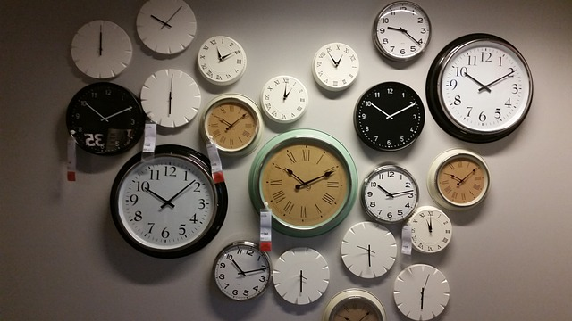
Licence Pixabay Content ilkown Kim
Notes:
Image par <a href="https://pixabay.com/fr/users/camera4u-588009/?utm_source=link-attribution&utm_medium=referral&utm_campaign=image&utm_content=534267">ilkown Kim</a> de <a href="https://pixabay.com/fr//?utm_source=link-attribution&utm_medium=referral&utm_campaign=image&utm_content=534267">Pixabay</a>

Slide 33
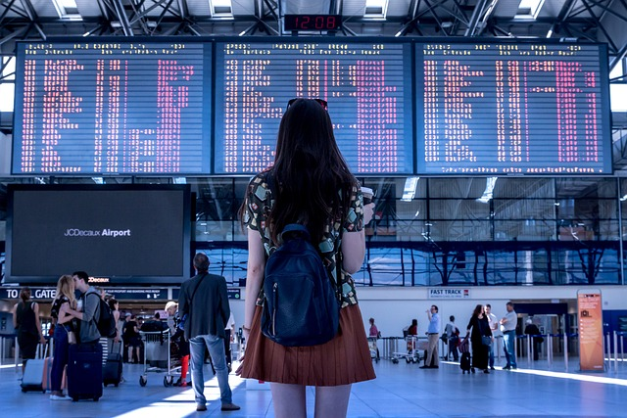
Licence Pixabay Content Jan Vašek
Notes:
Image par <a href="https://pixabay.com/fr/users/jeshoots-com-264599/?utm_source=link-attribution&utm_medium=referral&utm_campaign=image&utm_content=2373727">Jan Vašek</a> de <a href="https://pixabay.com/fr//?utm_source=link-attribution&utm_medium=referral&utm_campaign=image&utm_content=2373727">Pixabay</a>

Slide 34
Licence Pixabay Content Alexas
Notes:
Image par <a href="https://pixabay.com/fr/users/alexas_fotos-686414/?utm_source=link-attribution&utm_medium=referral&utm_campaign=image&utm_content=1738039">Alexa</a> de <a href="https://pixabay.com/fr//?utm_source=link-attribution&utm_medium=referral&utm_campaign=image&utm_content=1738039">Pixabay</a>

Slide 35
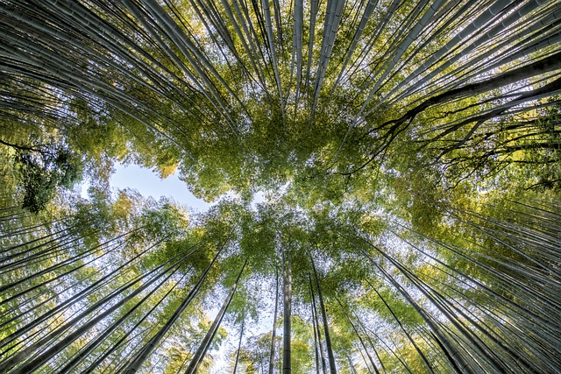
Licence Pixabay Content oadtz
Notes:
Image par <a href="https://pixabay.com/fr/users/oadtz-3657813/?utm_source=link-attribution&utm_medium=referral&utm_campaign=image&utm_content=1886974">Thanapat Pirmphol</a> de <a href="https://pixabay.com/fr//?utm_source=link-attribution&utm_medium=referral&utm_campaign=image&utm_content=1886974">Pixabay</a>

Slide 36
Licence Pixabay Content 18121281
Notes:
Image par <a href="https://pixabay.com/fr/users/18121281-18121281/?utm_source=link-attribution&utm_medium=referral&utm_campaign=image&utm_content=5533494">18121281</a> de <a href="https://pixabay.com/fr//?utm_source=link-attribution&utm_medium=referral&utm_campaign=image&utm_content=5533494">Pixabay</a>

Slide 37
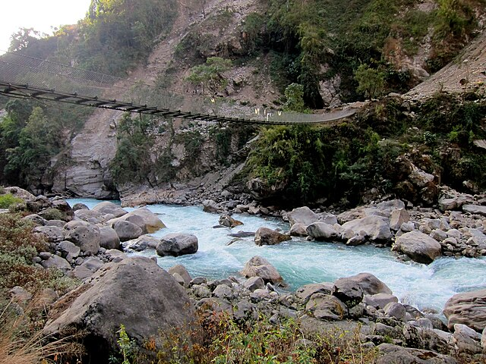
Wikicommons CC By 2.0 Andrew hyde
Notes:
By Andrew Hyde - Flickr: River crossing, CC BY 2.0, https://commons.wikimedia.org/w/index.php?curid=17892820

Slide 38
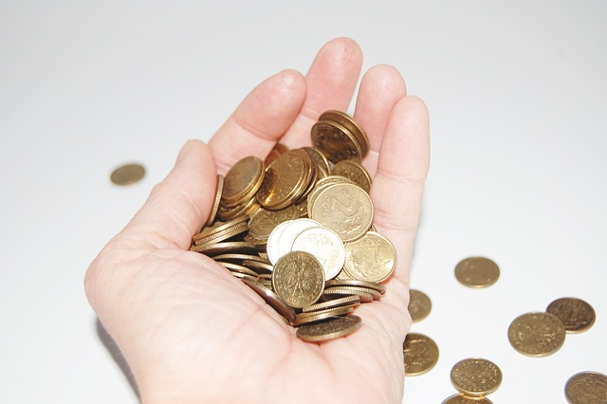
Licence Pixabay Content Mizianitka
Notes:
Image par <a href="https://pixabay.com/fr/users/mizianitka-568101/?utm_source=link-attribution&utm_medium=referral&utm_campaign=image&utm_content=621349">Mizianitka</a> de <a href="https://pixabay.com/fr//?utm_source=link-attribution&utm_medium=referral&utm_campaign=image&utm_content=621349">Pixabay</a>

Slide 39
Licence Pixabay Content Analogicus
Notes:
Image par <a href="https://pixabay.com/fr/users/analogicus-8164369/?utm_source=link-attribution&utm_medium=referral&utm_campaign=image&utm_content=3703469">Tom</a> de <a href="https://pixabay.com/fr//?utm_source=link-attribution&utm_medium=referral&utm_campaign=image&utm_content=3703469">Pixabay</a>

Slide 40
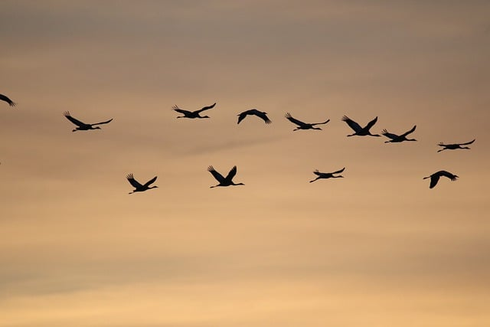
Licence Pixabay Content Nathalie Burblis
Notes:
Image par <a href="https://pixabay.com/fr/users/nathalieburblis-3857394/?utm_source=link-attribution&utm_medium=referral&utm_campaign=image&utm_content=7559487">nathalieburblis</a> de <a href="https://pixabay.com/fr//?utm_source=link-attribution&utm_medium=referral&utm_campaign=image&utm_content=7559487">Pixabay</a>

Slide 41
Licence Pixabay Content Kaboompics
Notes:
Image par <a href="https://pixabay.com/fr/users/kaboompics-1013994/?utm_source=link-attribution&utm_medium=referral&utm_campaign=image&utm_content=791029">Karolina Grabowska</a> de <a href="https://pixabay.com/fr//?utm_source=link-attribution&utm_medium=referral&utm_campaign=image&utm_content=791029">Pixabay</a>

Slide 42
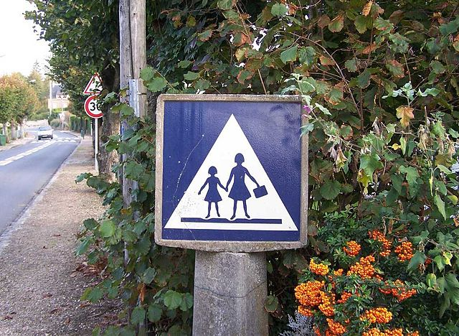
Wikicommons CC BY SA 3.0 Henry Salomé
Notes:
By ℍenry Salomé - Cliché personnel, own picture, CC BY-SA 3.0, https://commons.wikimedia.org/w/index.php?curid=1592355

Slide 43
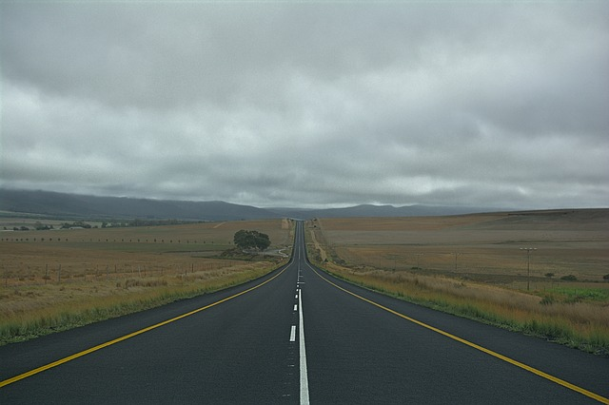
Licence Pixabay Content Mindz
Notes:
Image par <a href="https://pixabay.com/fr/users/mindz-2969436/?utm_source=link-attribution&utm_medium=referral&utm_campaign=image&utm_content=3573181">Mindz</a> de <a href="https://pixabay.com/fr//?utm_source=link-attribution&utm_medium=referral&utm_campaign=image&utm_content=3573181">Pixabay</a>

Slide 44
Photos non utilisées dans la version numérique

Slide 45
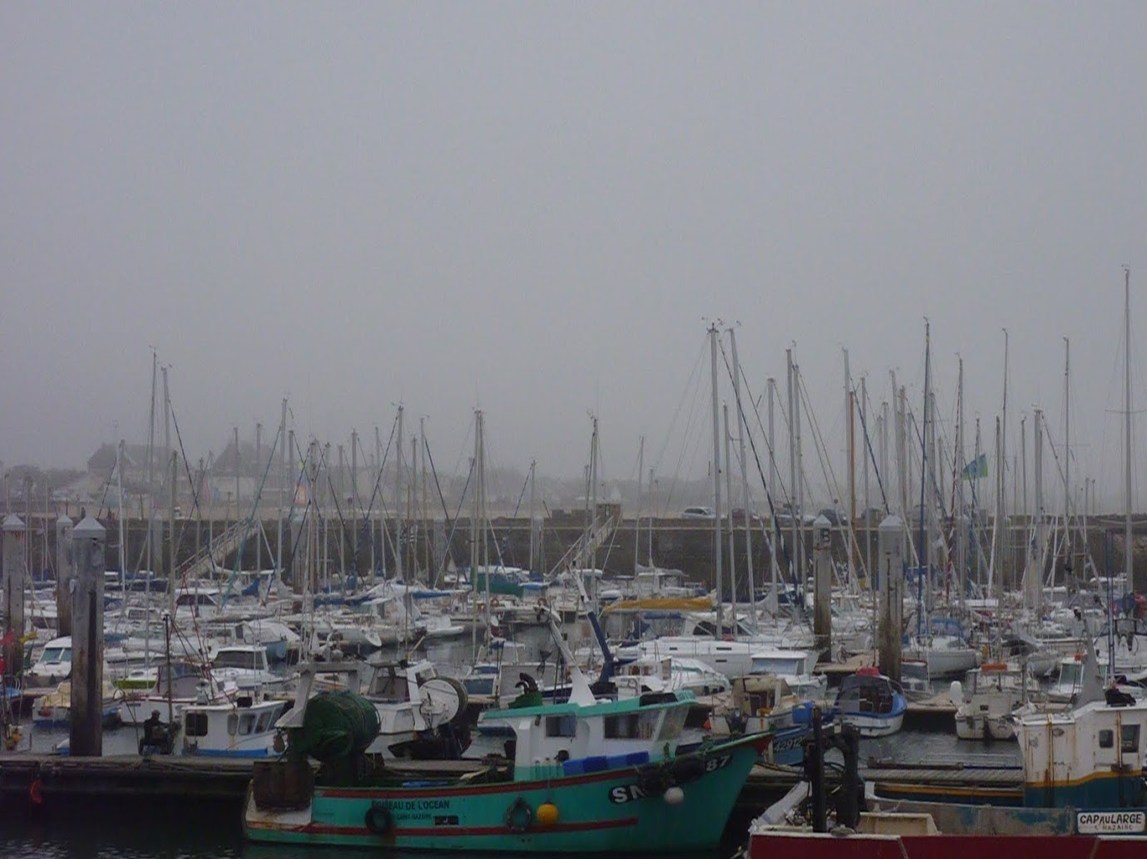
CC-BY-SA-NC Marie Jidenko
Notes:
Marie JIDENKO CC-BY-SA-NC

Slide 46
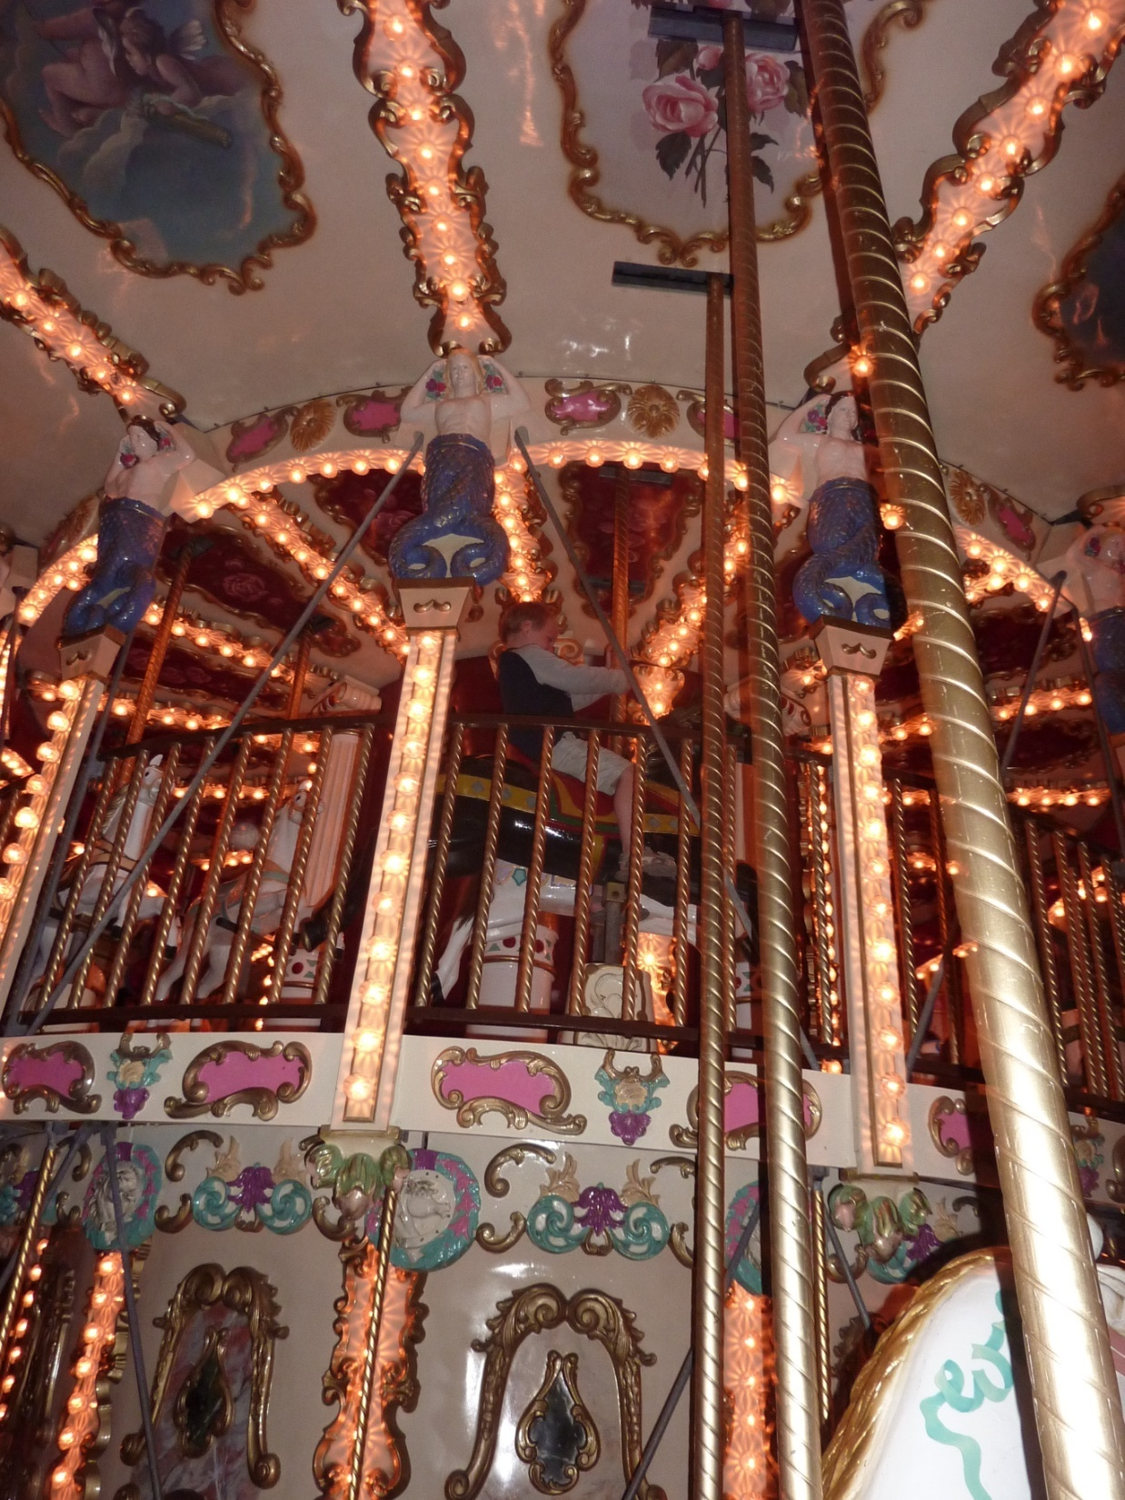
CC-BY-SA-NC Marie Jidenko
Notes:
Marie JIDENKO CC-BY-NC-SA

